Slide 1
Food Wallet- Training for merchants
In this module we will discuss:
What is Food wallet?
How to login and access Food wallet on the merchant panel
Understanding business wallet, sub-wallet & customer wallet
Understanding various tabs on the panel
What are the various reports available

Slide 2
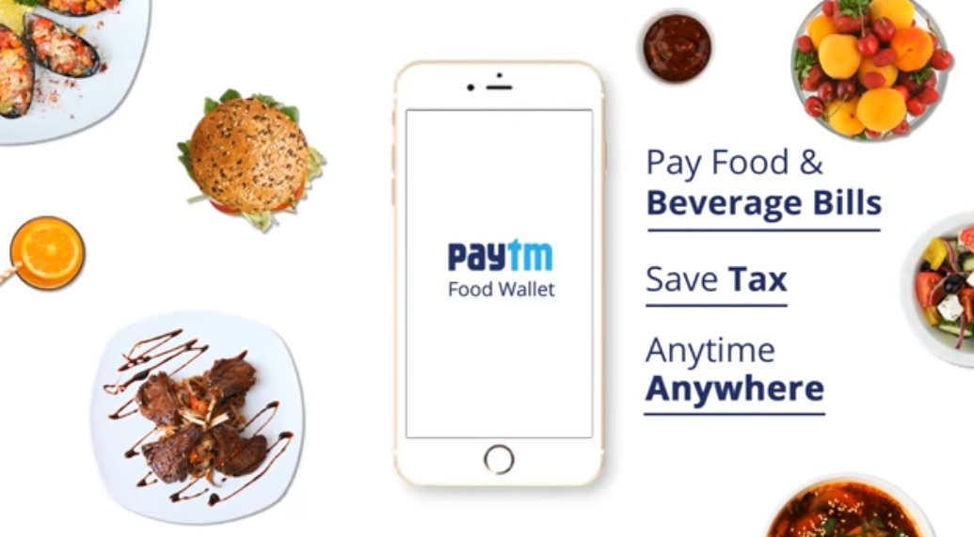
1
Food Wallet Guide
Food wallet
Corporates can opt for Food wallet which can be provided to the employees as an additional benefit which would also help the employees save tax. Employees can opt for Food wallet facility and while paying for any edible item, amount would get deducted from their Food wallet. It’s a quick and easy method of payment on the go

Slide 3
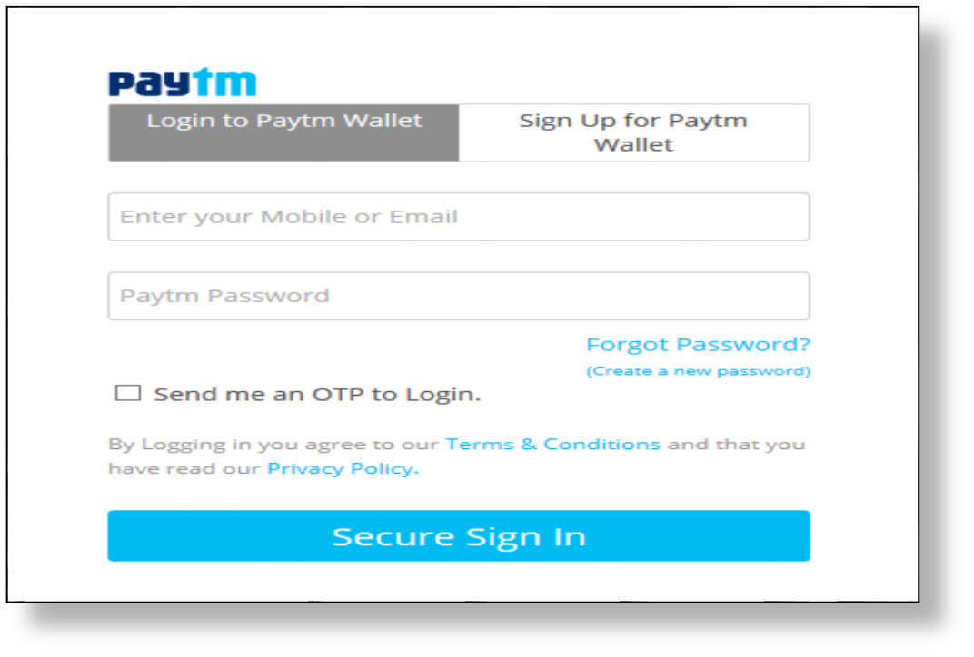





1
Food Wallet Guide
Login to Merchant panel & access Food Wallet
Login to the panel - https://dashboard.paytm.com/
1
Click on Log in
2
Enter your access details
3
Click on Secure Login

Slide 4
1
Food Wallet Guide
Reset Password
1
Click on Forgot Password?

Slide 5
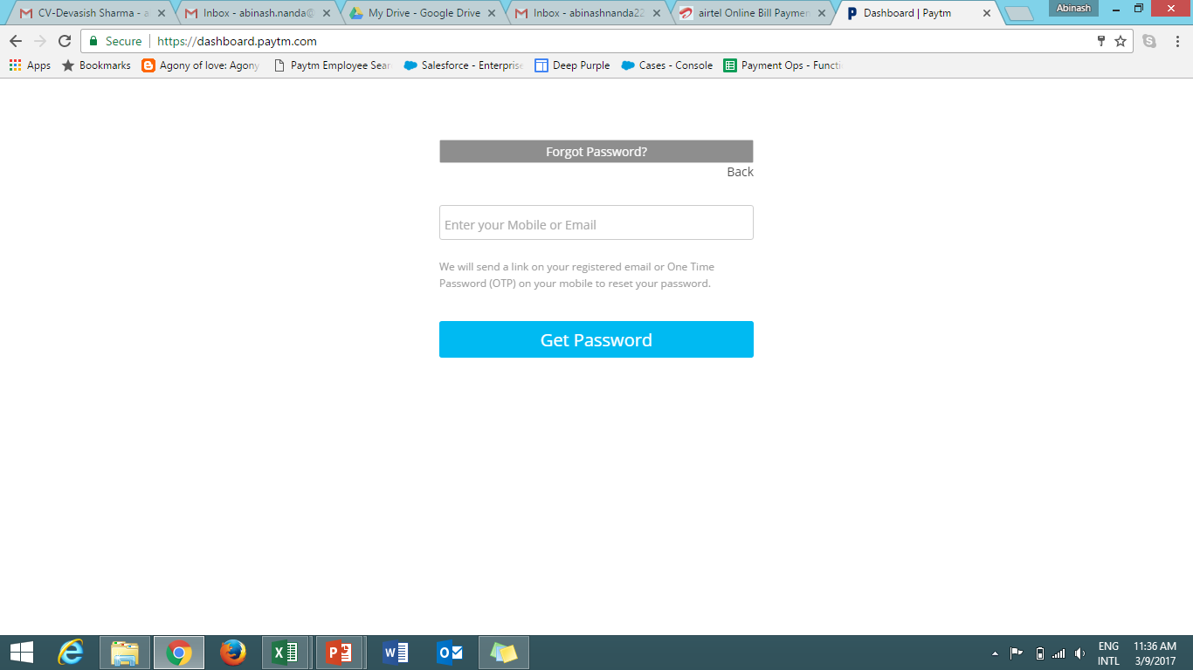
1
Food Wallet Guide
Reset Password
2
Enter Paytm registered mobile number / email
3
Click on Get Password
A link will be sent to the registered mobile number / email that will redirect you to changing your password page
2
3

Slide 6
1
Food Wallet Guide
Understand wallet types
Business Wallet- Your primary wallet is where funds would be transferred by Paytm in lieu
of fund received against the business entity
Sub -Wallet- Funds are transferred from the business wallet to sub wallet/food wallet which would be created by organizations and then employees can use the fund stored for buying edibles, multiple sub wallets can be created as per requirement
Employee/Customer Wallet- This is the regular Paytm wallet of any shopkeeper who will be the end beneficiary
employee 1
Sub wallet1
employee 2
Business wallet
employee 1
Sub wallet2
employee3

Slide 7
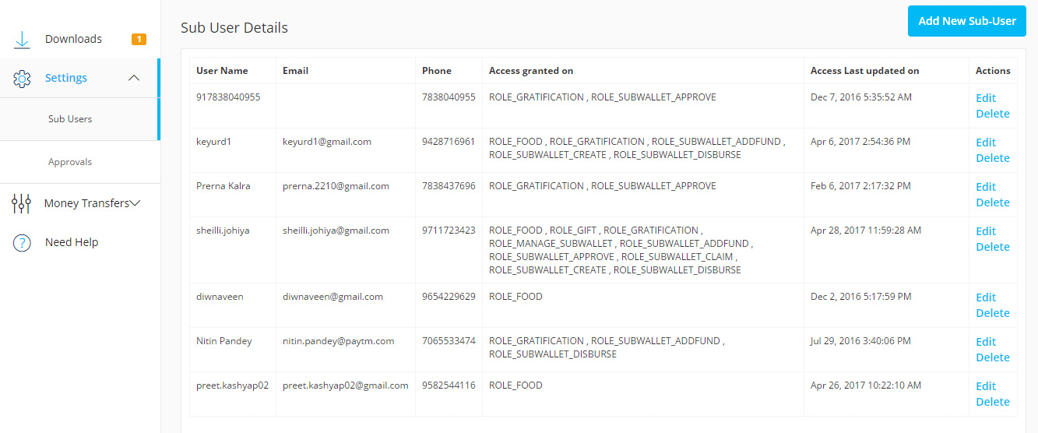
1
Food Wallet Guide
A
Settings
i
Sub users
Add sub users to the panel – Step 1
You can create sub users with restricted access. Use mobile number or email to create sub-users from the “Sub Users” tab under the Settings section
2
1
Click on Sub Users under Settings tab
1
2 A
2
Click on Add New Sub-User
2 A
To Edit or Delete an already existing sub user click on appropriate option

Slide 8
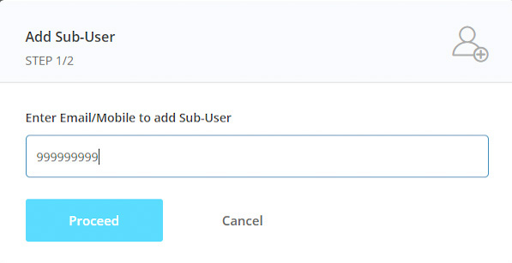
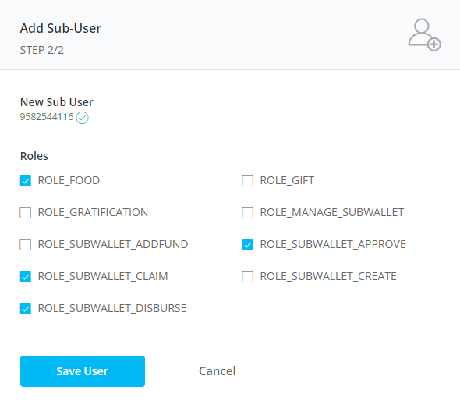
1
Food Wallet Guide
A
Settings
i
Sub users
Add sub users to the panel – Step 2
3
Enter email / mobile number
This can be either Paytm registered or not
5
4
Click on Proceed
3
5
Choose the wallet type and then roles or views that sub user can see
4
6
Click on Save user
6

Slide 9
1
Food Wallet Guide
A
Settings
i
Sub users
You can look at the following example to understand how roles can be assigned by Admin that is you to your sub-users for different sub-wallets. We are looking at the structure of XYZ Company:
CFO1 can access Sub – Wallet 1 (Add Funds, Claim Funds & Approve)
Manager1-
Can Disburse Funds with approval from CFO1 or CFO2 or Admin for Sub-Wallet 1
MD-XYZ Company- Has all the access & only Admin can create sub-users
CFO2 can access Sub – wallet 1 & 2 (Add Claim, Disburse Funds & Approve)
Manager2-
Can Disburse Funds with approval from CFO1 or CFO2 or Admin for Sub-Wallet 1 & 2
& can also create sub-wallet
CFO3 can access Sub – wallet 3 (Add Funds, Claim Funds & Disburse Funds )
Manager3-
Can Claim Funds for Sub-Wallet3 & create sub-wallet

Slide 10
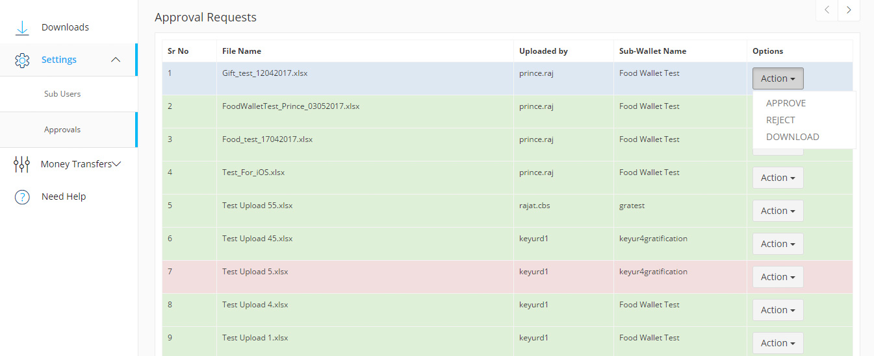
1
Food Wallet Guide
A
Settings
ii
Approvals
Approvals of uploaded file
Under this tab Admin or Sub-User with access to Approve can View, Download, Approve or Reject the file that has been generated by releasing Disbursement, once approval/rejection is done, user can only download the file
1
Click on Approvals under Settings
2
2
Here you can see the file uploaded, Select the file & click on Action to Approve, reject or Download the file
1
NOTE: Files that need action would reflect in white, rejected files would reflect in red and approved files would reflect in blue

Slide 11
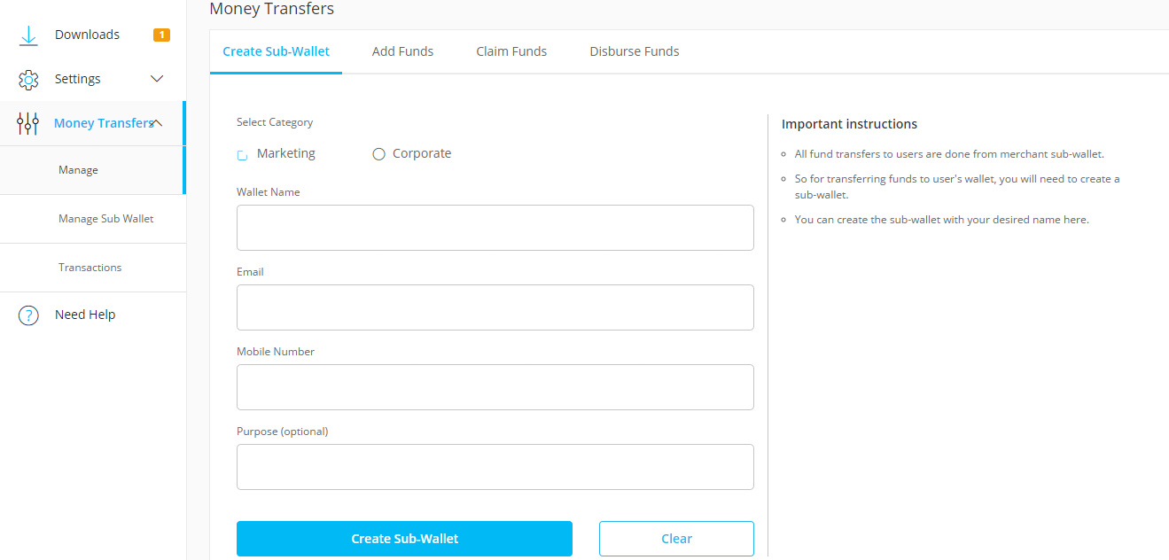
1
Food Wallet Guide
B
Money Transfer
i
Manage– Create Sub-Wallet
Create Sub-Wallet
You can create sub wallets by clicking on sub wallet tab and following the mentioned steps
2
1
Click on Money Transfer– Manage
1
8
2
Click on Create Sub-Wallet
3
3
If you have multiple wallet access then two categories would reflect. Select Corporate for Food Wallet
4
4
Type a wallet name
5
5
Enter email ID & mobile no.
6
6
Put a purpose (Optional)
7
7
Click on Create Sub-Wallet
8
Read the instructions

Slide 12
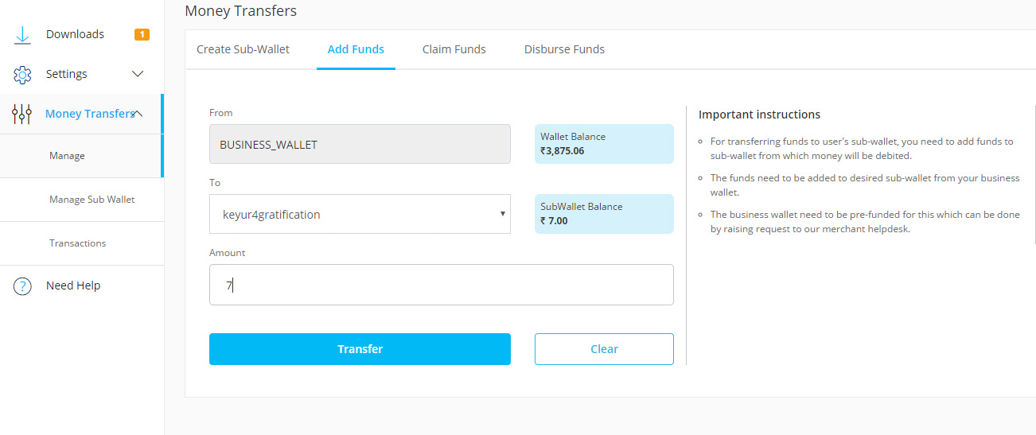
1
Food Wallet Guide
B
Money Transfer
ii
Manage-- Add Funds
Add Money to sub wallet
You can transfer money to your sub wallet by following these steps
2
1
Click on Money Transfer– Manage
1
6
2
Click on Add Funds
3
Under To select Sub-Wallet
3
4
Enter the amount
4
5
Click on Transfer
5
6
Read the instructions
NOTE: Amount entered should be equal to or less than the amount available in business wallet

Slide 13
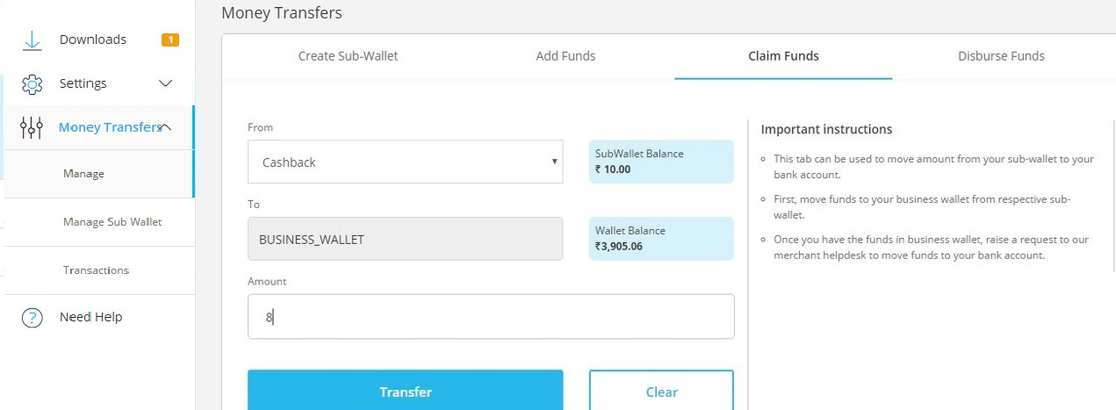
1
Food Wallet Guide
B
Money Transfer
iii
Manage– Claim Funds
Send money back to Business wallet
Amount can also be rolled back from Sub-wallet to Business wallet, follow these steps
1
Click on Money Transfer– Manage
2
1
2
Click on Claim Funds
6
3
3
Under From select Sub-Wallet
4
Enter the amount
5
Click on Transfer
4
6
Read the instructions
5

Slide 14
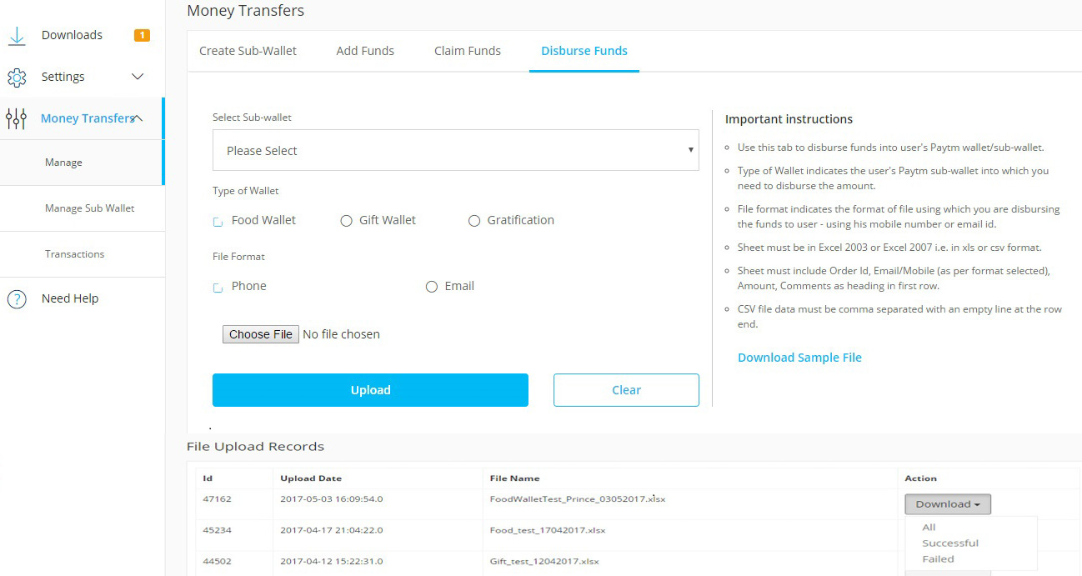
1
Food Wallet Guide
B
Money Transfer
iv
Manage – Disburse Funds
Disburse Funds
By following these steps, funds can be disbursed to employee’s wallet
1
Click on Money Transfer-- Manage
2
2
1
Click on Disburse Funds
4
3
Click to Download Sample File & manually fill the data
5
4
Select the Sub-wallet, you want to transfer the amount from
6
5
Select Food under Type of wallet
7
8
3
6
Select phone or email
7
Choose the saved xls or csv file
9
8
Click on Upload
9
All the files uploaded would reflect here, it can be filtered and downloaded status wise

Slide 15
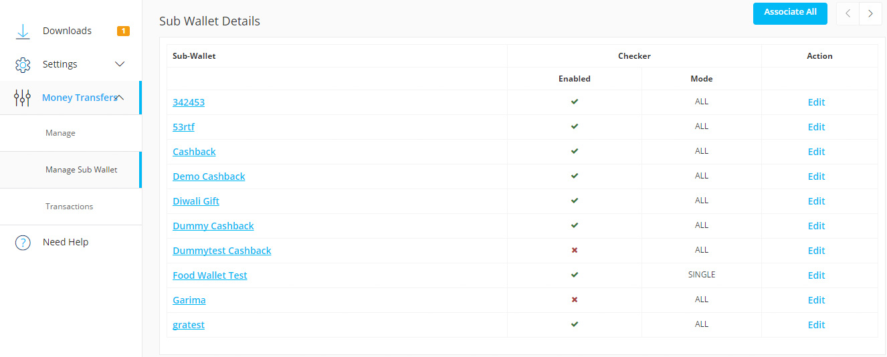
1
Food Wallet Guide
B
Money Transfer
v
Manage Sub wallet
Provide access right to Sub-User for specific Sub-Wallet Step-1
For accessing any specific Sub-Wallet each Sub-User will require a permission from Admin that was provided while creating Sub-User and those rights need to be made active from the “Manage Sub-Wallet” tab
1
Click on Manage Sub Wallet under Money Transfer
2
A new Sub wallet which has been created but not mapped with Sub Users would look like this with a red cross sign, Click on edit next to it to enable mapping
1
2

Slide 16
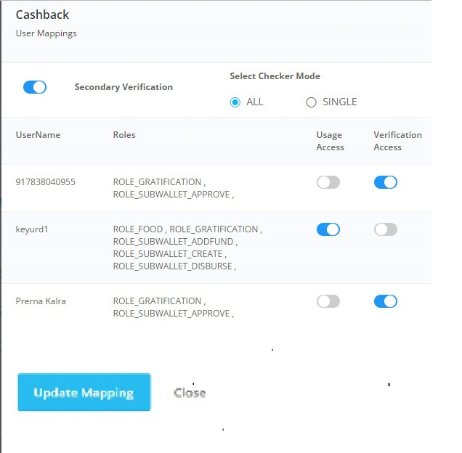
1
Food Wallet Guide
B
Money Transfer
v
Manage Sub wallet
Provide access right to Sub-User for specific Sub-Wallet Step-2
4
Click on secondary verification which would enable Approvals from Admin or another Sub-User having right to approve
4
5
6
5
Click on All to select multiple Approver & in this case approval is required from every approver
7
6
Click on Usage access button next to Sub-User to activate usage access
7
Click on Verification access button next to Sub-User to activate Approval access, for approving Sub-User need to have access to specific wallet and Approval right
8
8
Click on Update Mapping

Slide 17
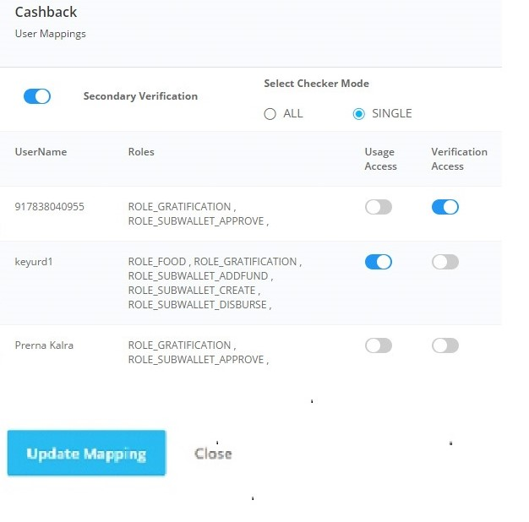
1
Food Wallet Guide
B
Money Transfer
v
Manage Sub wallet
Provide access right to Sub-User for specific Sub-Wallet Step-3
9
Click on Single & any one approver can go ahead with the approval
9
10
Click on Usage access to activate usage of Roles assigned
11
10
Click on Verification access button next to Sub-User to activate Approval access, for approving Sub-User need to have access to specific wallet and Approval right
11
12
Click on Update Mapping
12

Slide 18
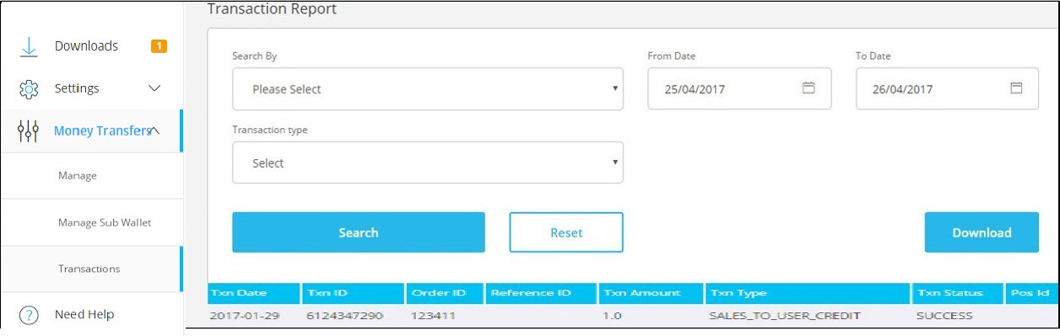
1
Food Wallet Guide
B
Money Transfer
vi
Transactions
Transaction Report
This report will allow you to check & download your daily transaction report status wise.
1
Click on Transaction under Money Transfer
2
2
Apply the date filter (Max 1 month)
3 A
3
Select Transaction type
3
Apply additional filters
3 A
4
6
1
4
Click on Search
5
5
Transaction summary will pop up below
6
Click on Download to download the report
NOTE: Available report status- Success, Pending & Failure

Slide 19
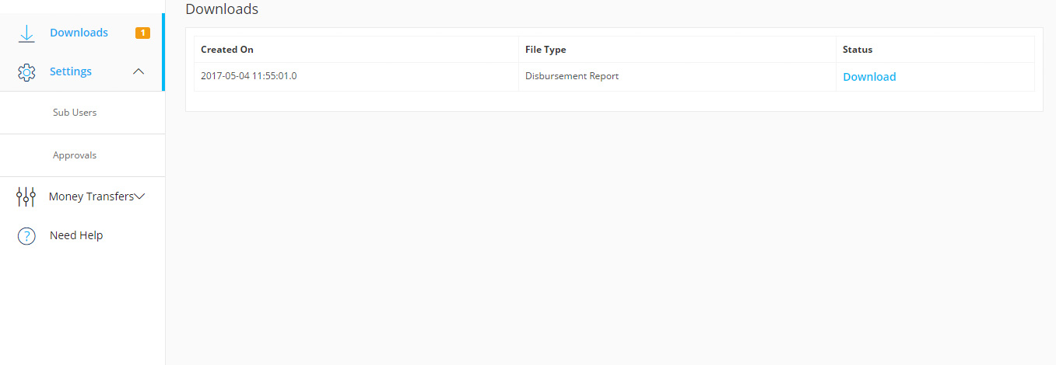
1
Food Wallet Guide
C
Downloads
Downloading requested reports
Download reports from this section you requested for download by clicking on download option under a particular report tab. This tab shows the 20 recent downloaded reports only
1
1
Click on Downloads
2
2
All reports once downloaded will be queued here.
Click on Download against the particular request

Slide 20
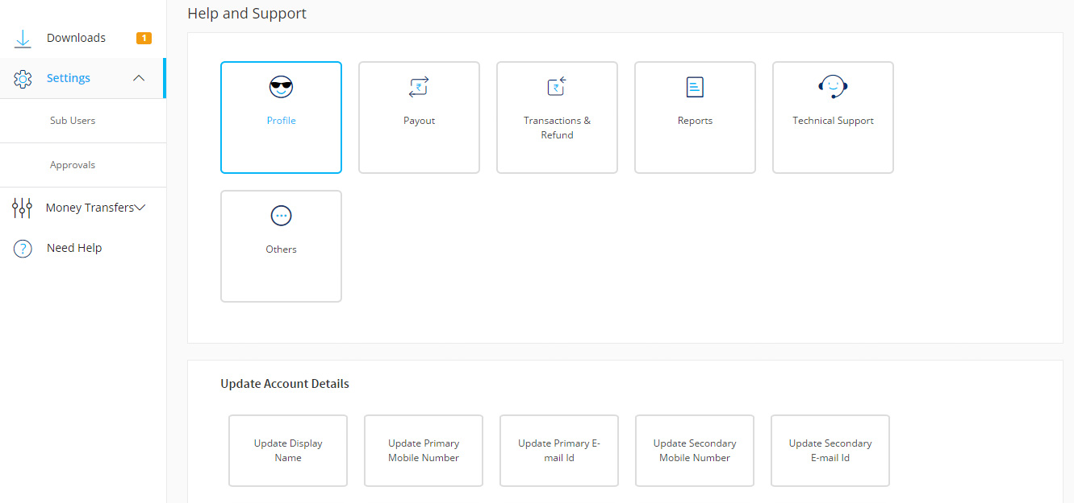
1
Food Wallet Guide
D
Need help
i
Profile
“Need Help” section on the panel would allow you to raise tickets for various issues you face
As an example How can you raise a ticket to update your display name is shown below
1
Click on Need Help
2
2
Select the category as per your issue, here we have Selected Profile
1
3
Select the issue, here we have Update Account Details
3
4
Select the sub issue, here we have selected Update Display Name
4

Slide 21
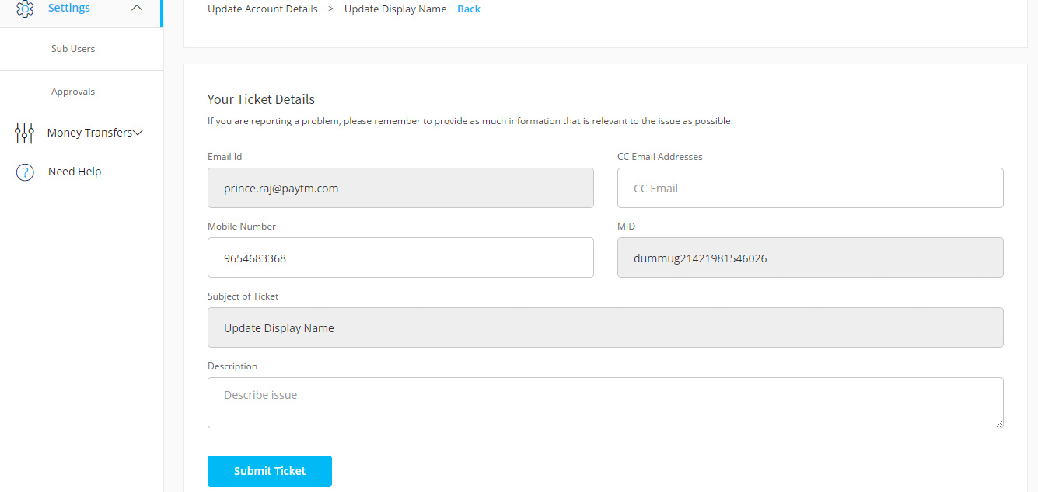
1
Food Wallet Guide
D
Need help
i
Profile
Example – How to raise a ticket to update your display name ?
5
Enter the details asked for
6
Mention description about the issue.
7
Click on Submit Ticket
5
6
7

Slide 22
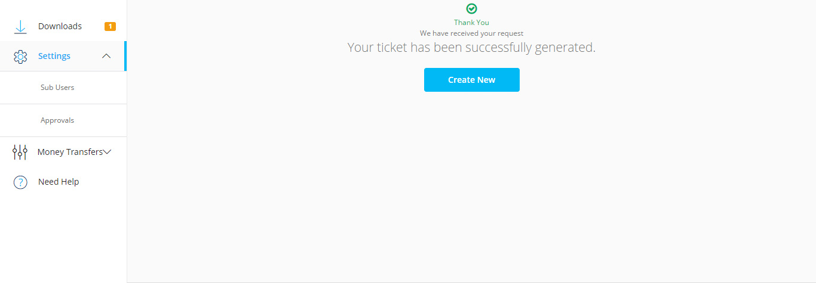
1
Food Wallet Guide
D
Need help
i
Profile
Example – How to raise a ticket to update your display name ?
8
You will get get an acknowledgement of your ticket
8

Slide 23

For further queries please click ‘Need Help’ on Panel to raise your ticket
Thank you!

